Slide 1
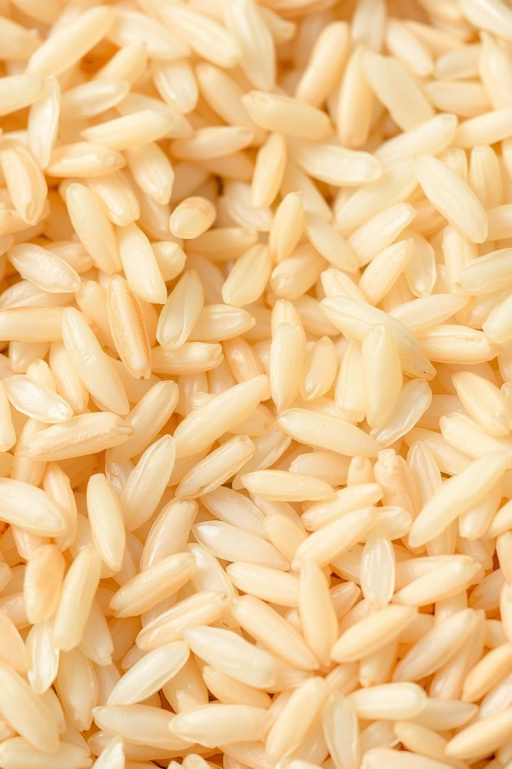
GrainPalette: A Deep Learning Odyssey in Rice-Type Classification through Transfer Learning
Unlocking the potential of AI for agricultural precision.

Slide 2
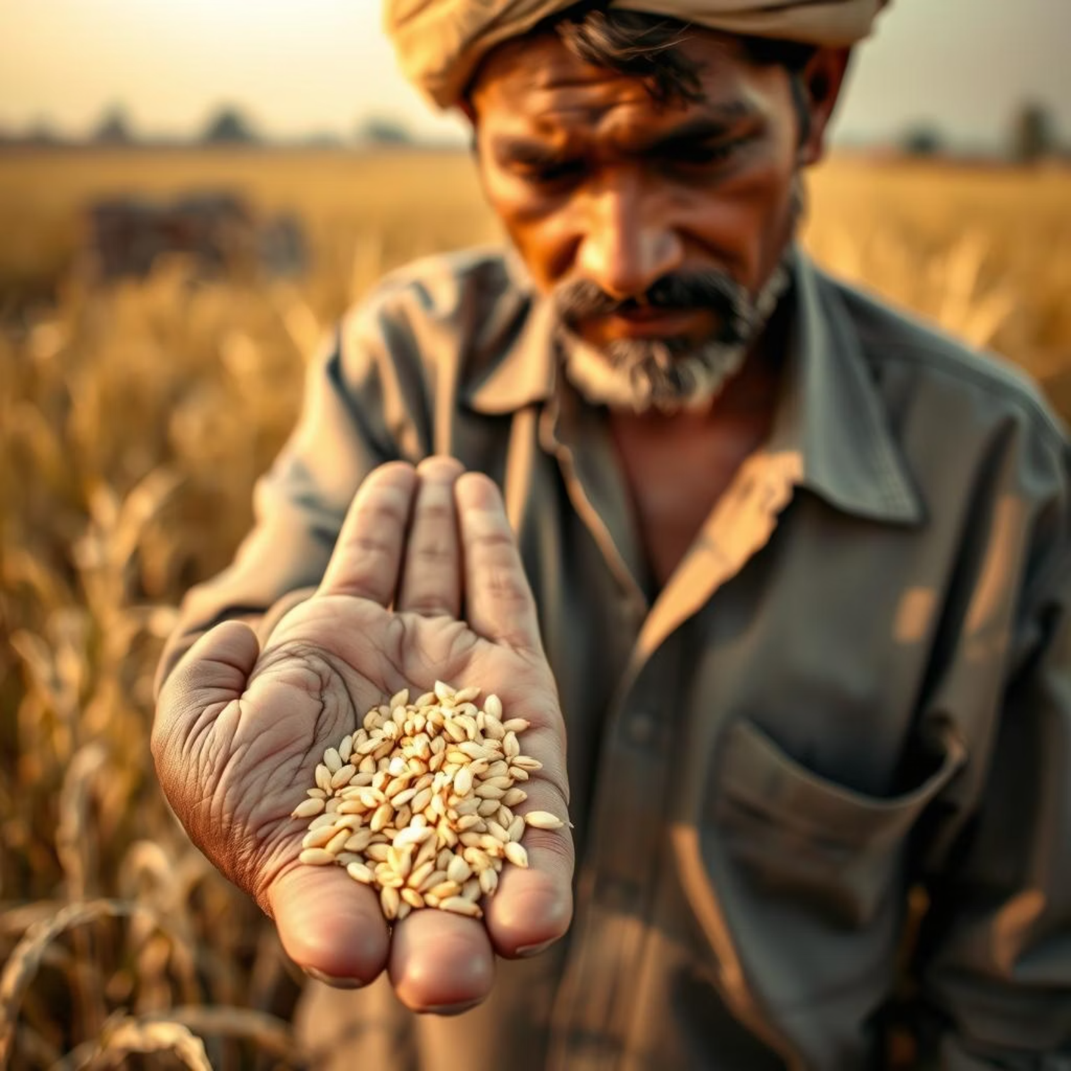
The Rice Bowl Challenge: Why Precise Classification Matters for Bharat
India's agricultural backbone: Rice is a staple, critical
for food security and economy.
Quality control: Essential for market value, export,
and consumer satisfaction.
Adulteration concerns: Accurate classification
combats mixing of varieties.

Slide 3




Unravelling the Grains: The Complexities of Discerning Rice Varieties Visually
Subtle Differences
Manual Inspection
Minute variations in shape, size, and colour.
Labour-intensive, prone to human error and inconsistency.
Environmental Factors
Lighting and moisture can alter appearance.

Slide 4
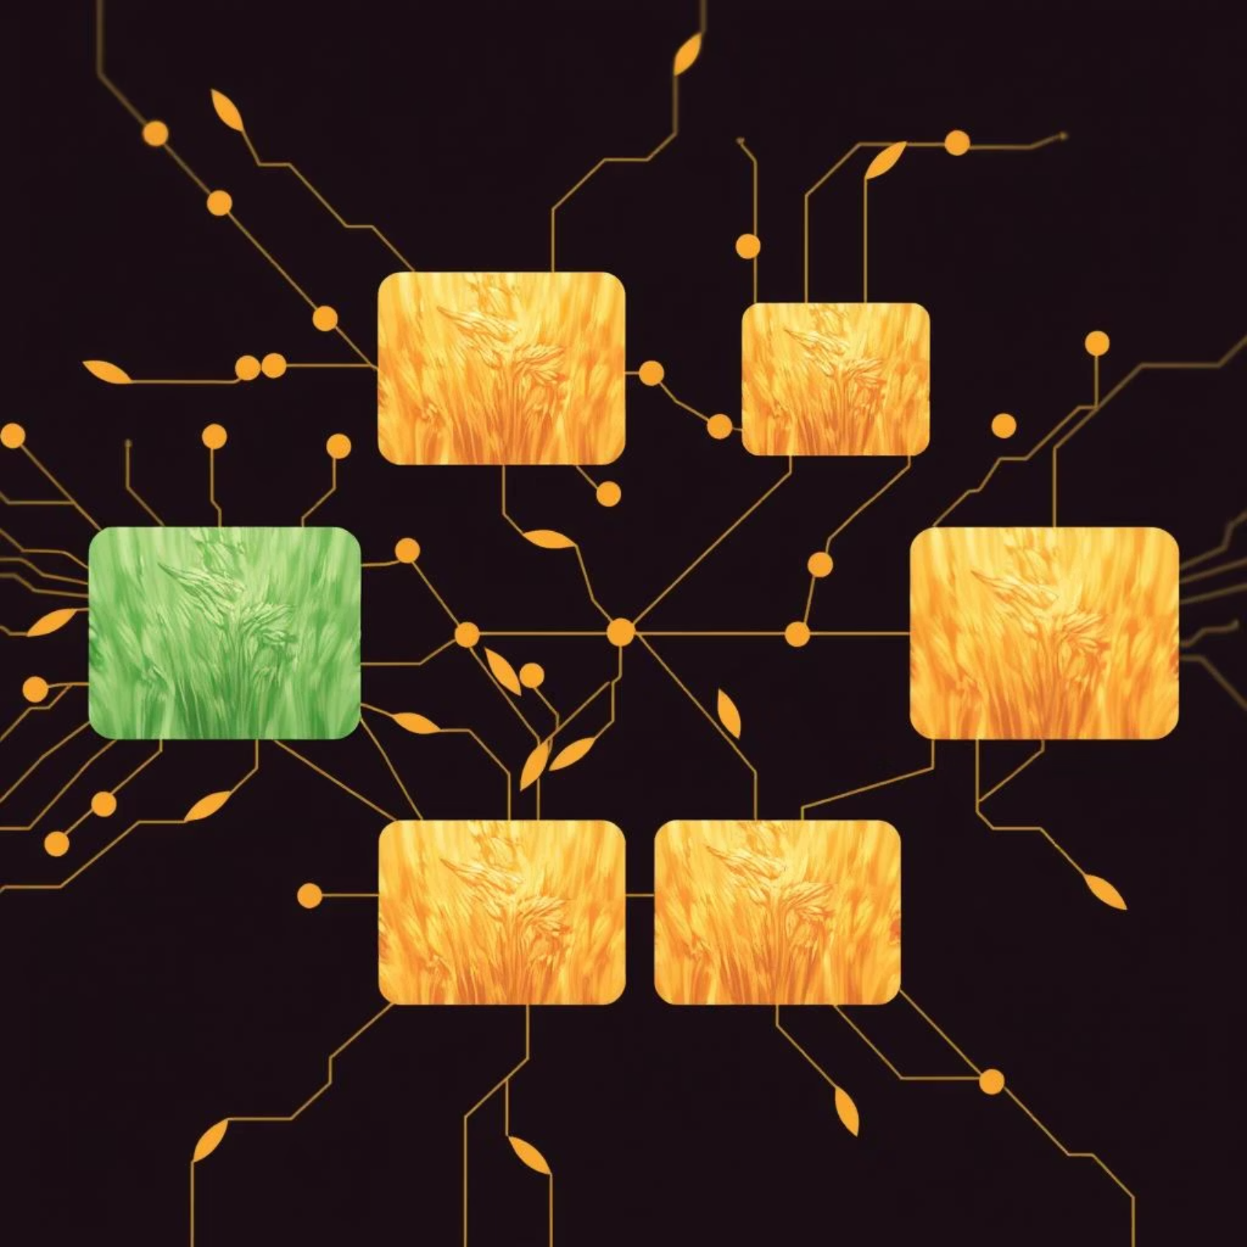
Our Digital Plough: Deep Learning as the Game Changer for Precision
Automated Accuracy: Eliminates human bias
and improves consistency.
Speed & Efficiency: Rapid classification of large
volumes.
Scalability: Easily deployable across various agricultural
settings.

Slide 5





The 'Transfer' Advantage: Leveraging Pre-trained Models for Quicker, Smarter Classification
Pre-trained Power
Utilises models trained on vast image datasets.
Feature Extraction
Learns complex features from initial layers.
Fine-tuning
Adapts to specific rice grain characteristics.
Reduced Training Time
Faster development and deployment.

Slide 6
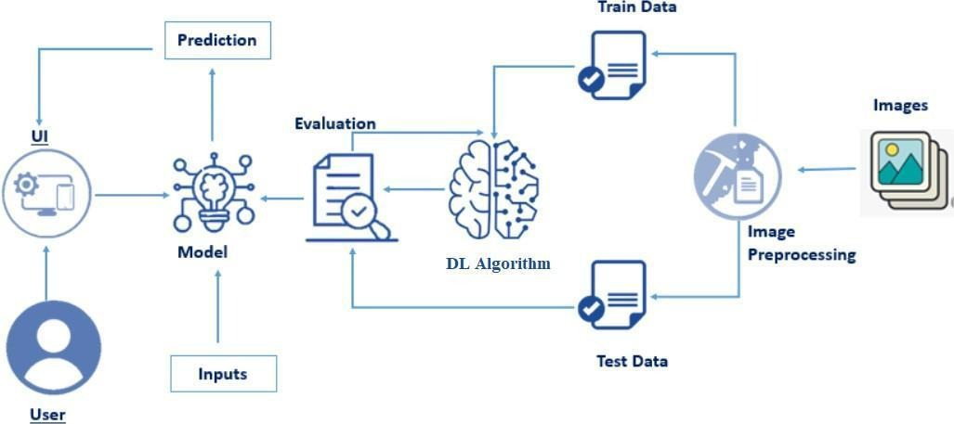
Model Architecture:

Slide 7
Inside GrainPalette: Our Model Architecture and Fine-tuning Strategy
Pre-trained Backbone
1
ResNet50 chosen for its robust feature learning.
Custom Classification Head
2
Added layers for specific rice type output.
Fine-tuning
3
Low learning rates for adapting final layers.
Optimisation
4
Adam optimizer with early stopping for best results.

Slide 8

Harvesting Data: Our Datasets, Pre-processing, and Experimental Journey
Diverse Datasets: Collected images of various Indian
rice types.
Pre-processing: Resizing, normalisation, and
augmentation.
Experimental Setup: Rigorous testing and validation
splits.
Iterative Refinement: Continuous model improvement.

Slide 9
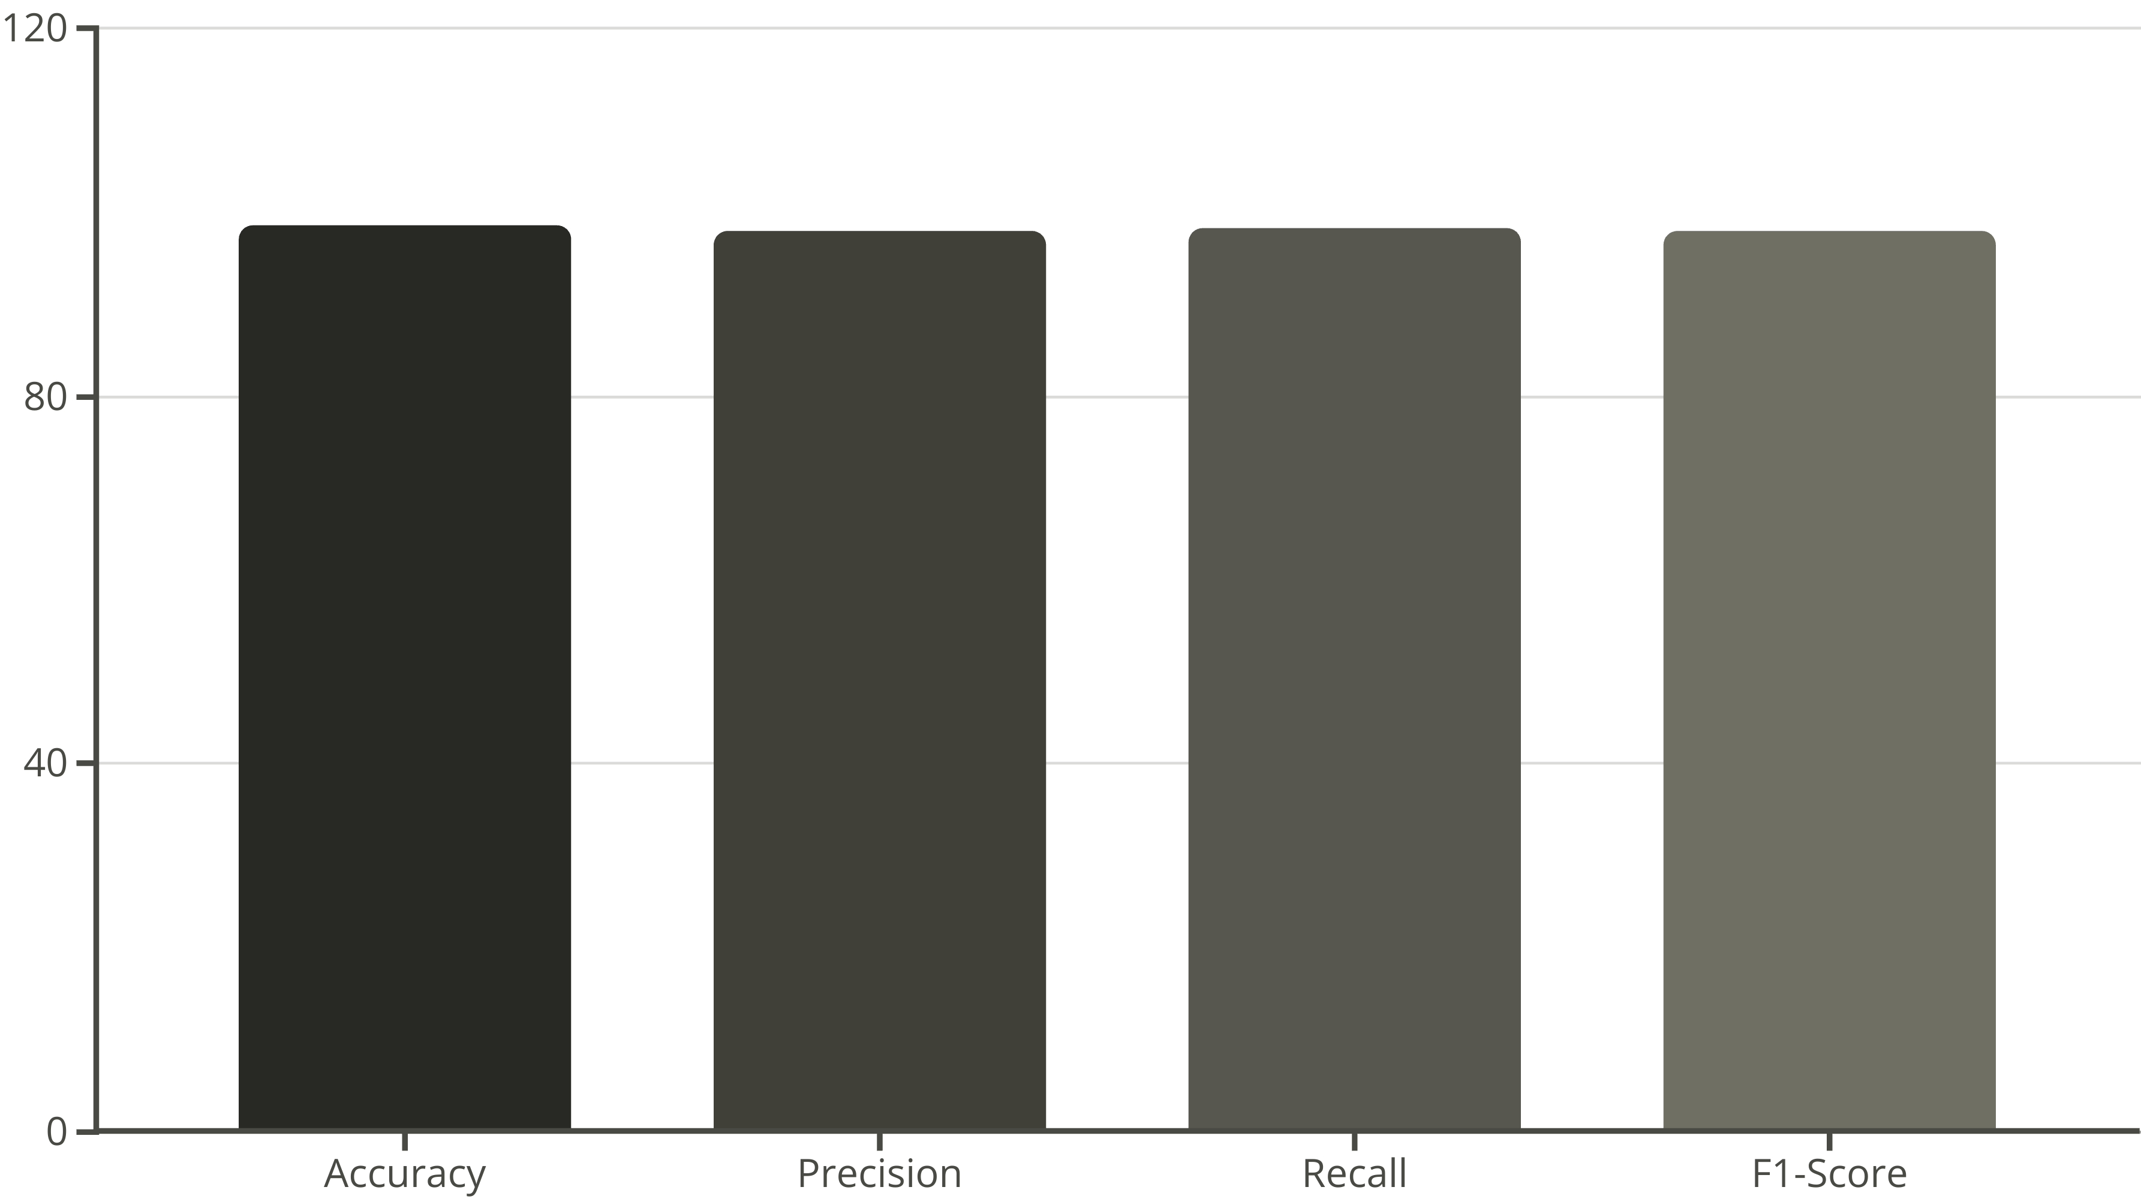
The Proof in the Paddy: GrainPalette's Performance Metrics and Robust Results
GrainPalette achieved exceptional results, demonstrating high accuracy and reliability across all tested rice varieties.

Slide 10
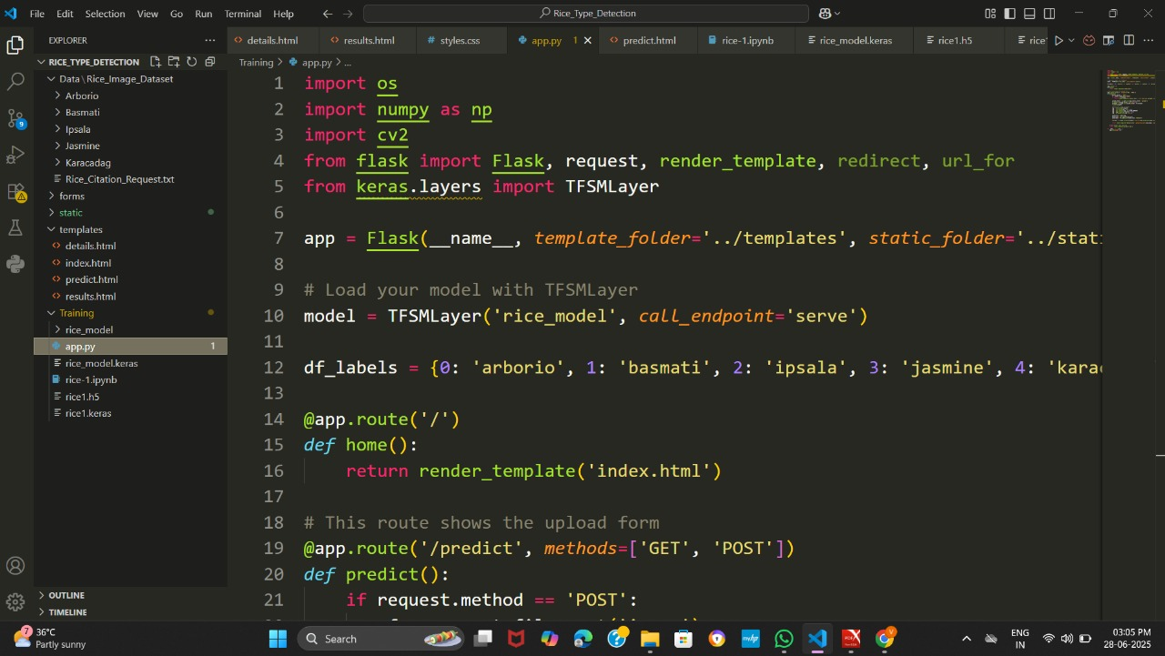

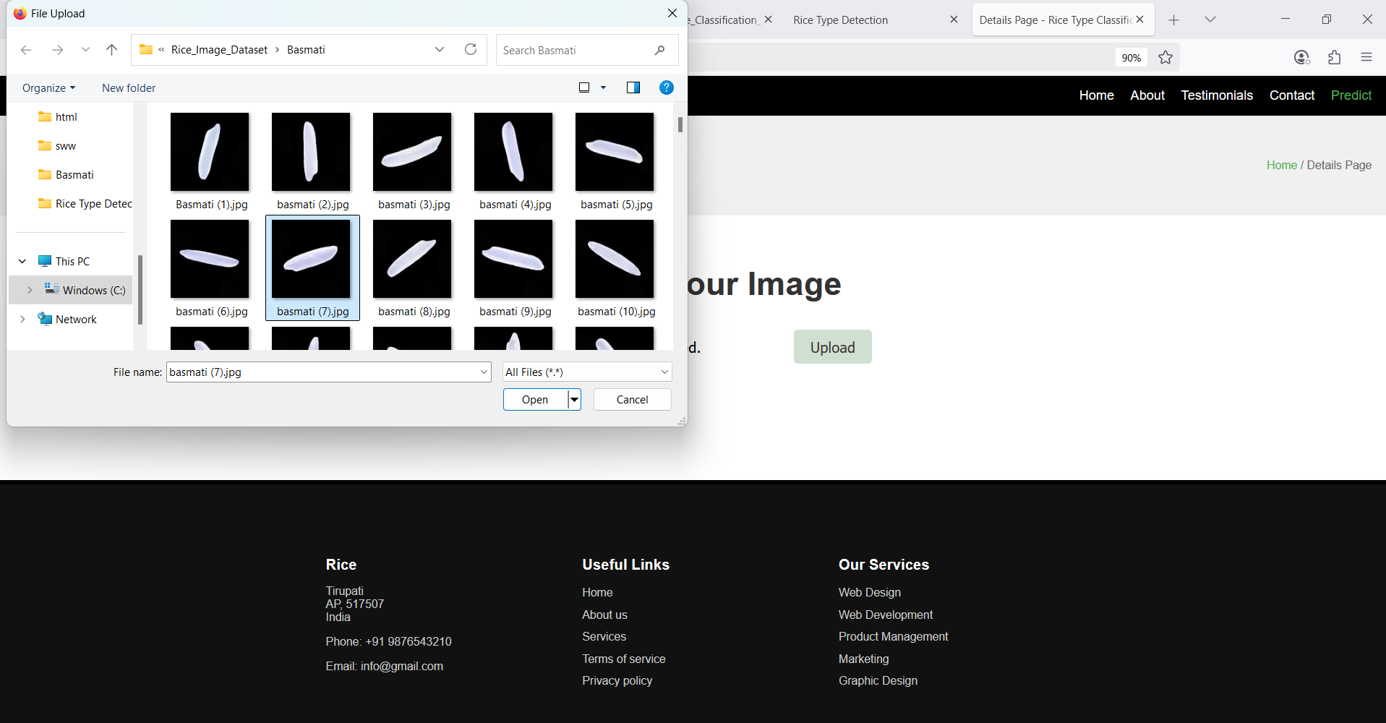
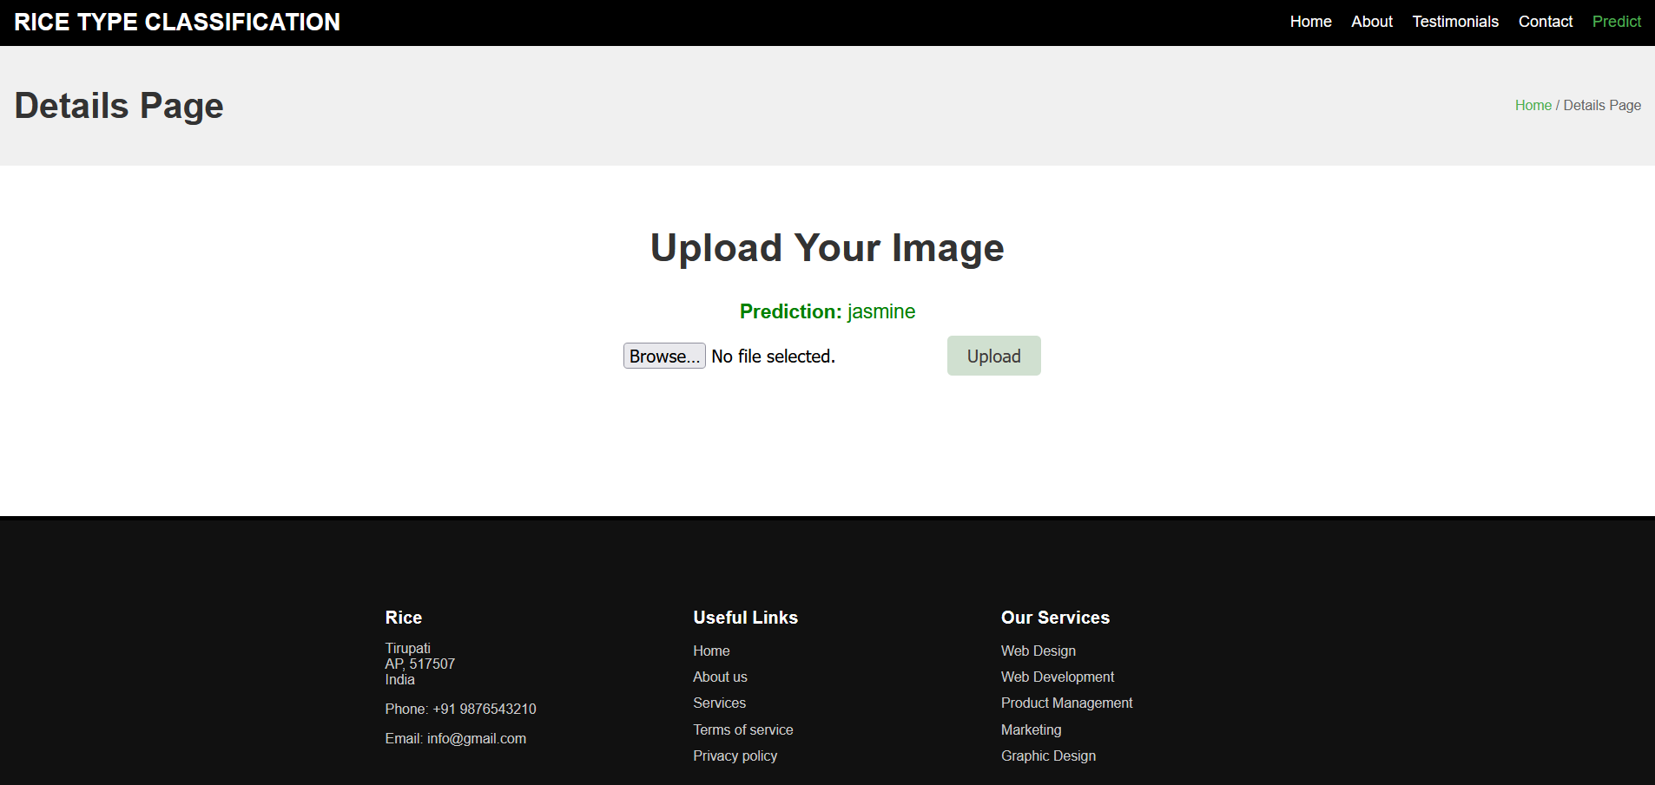
Prediction result:

Slide 11
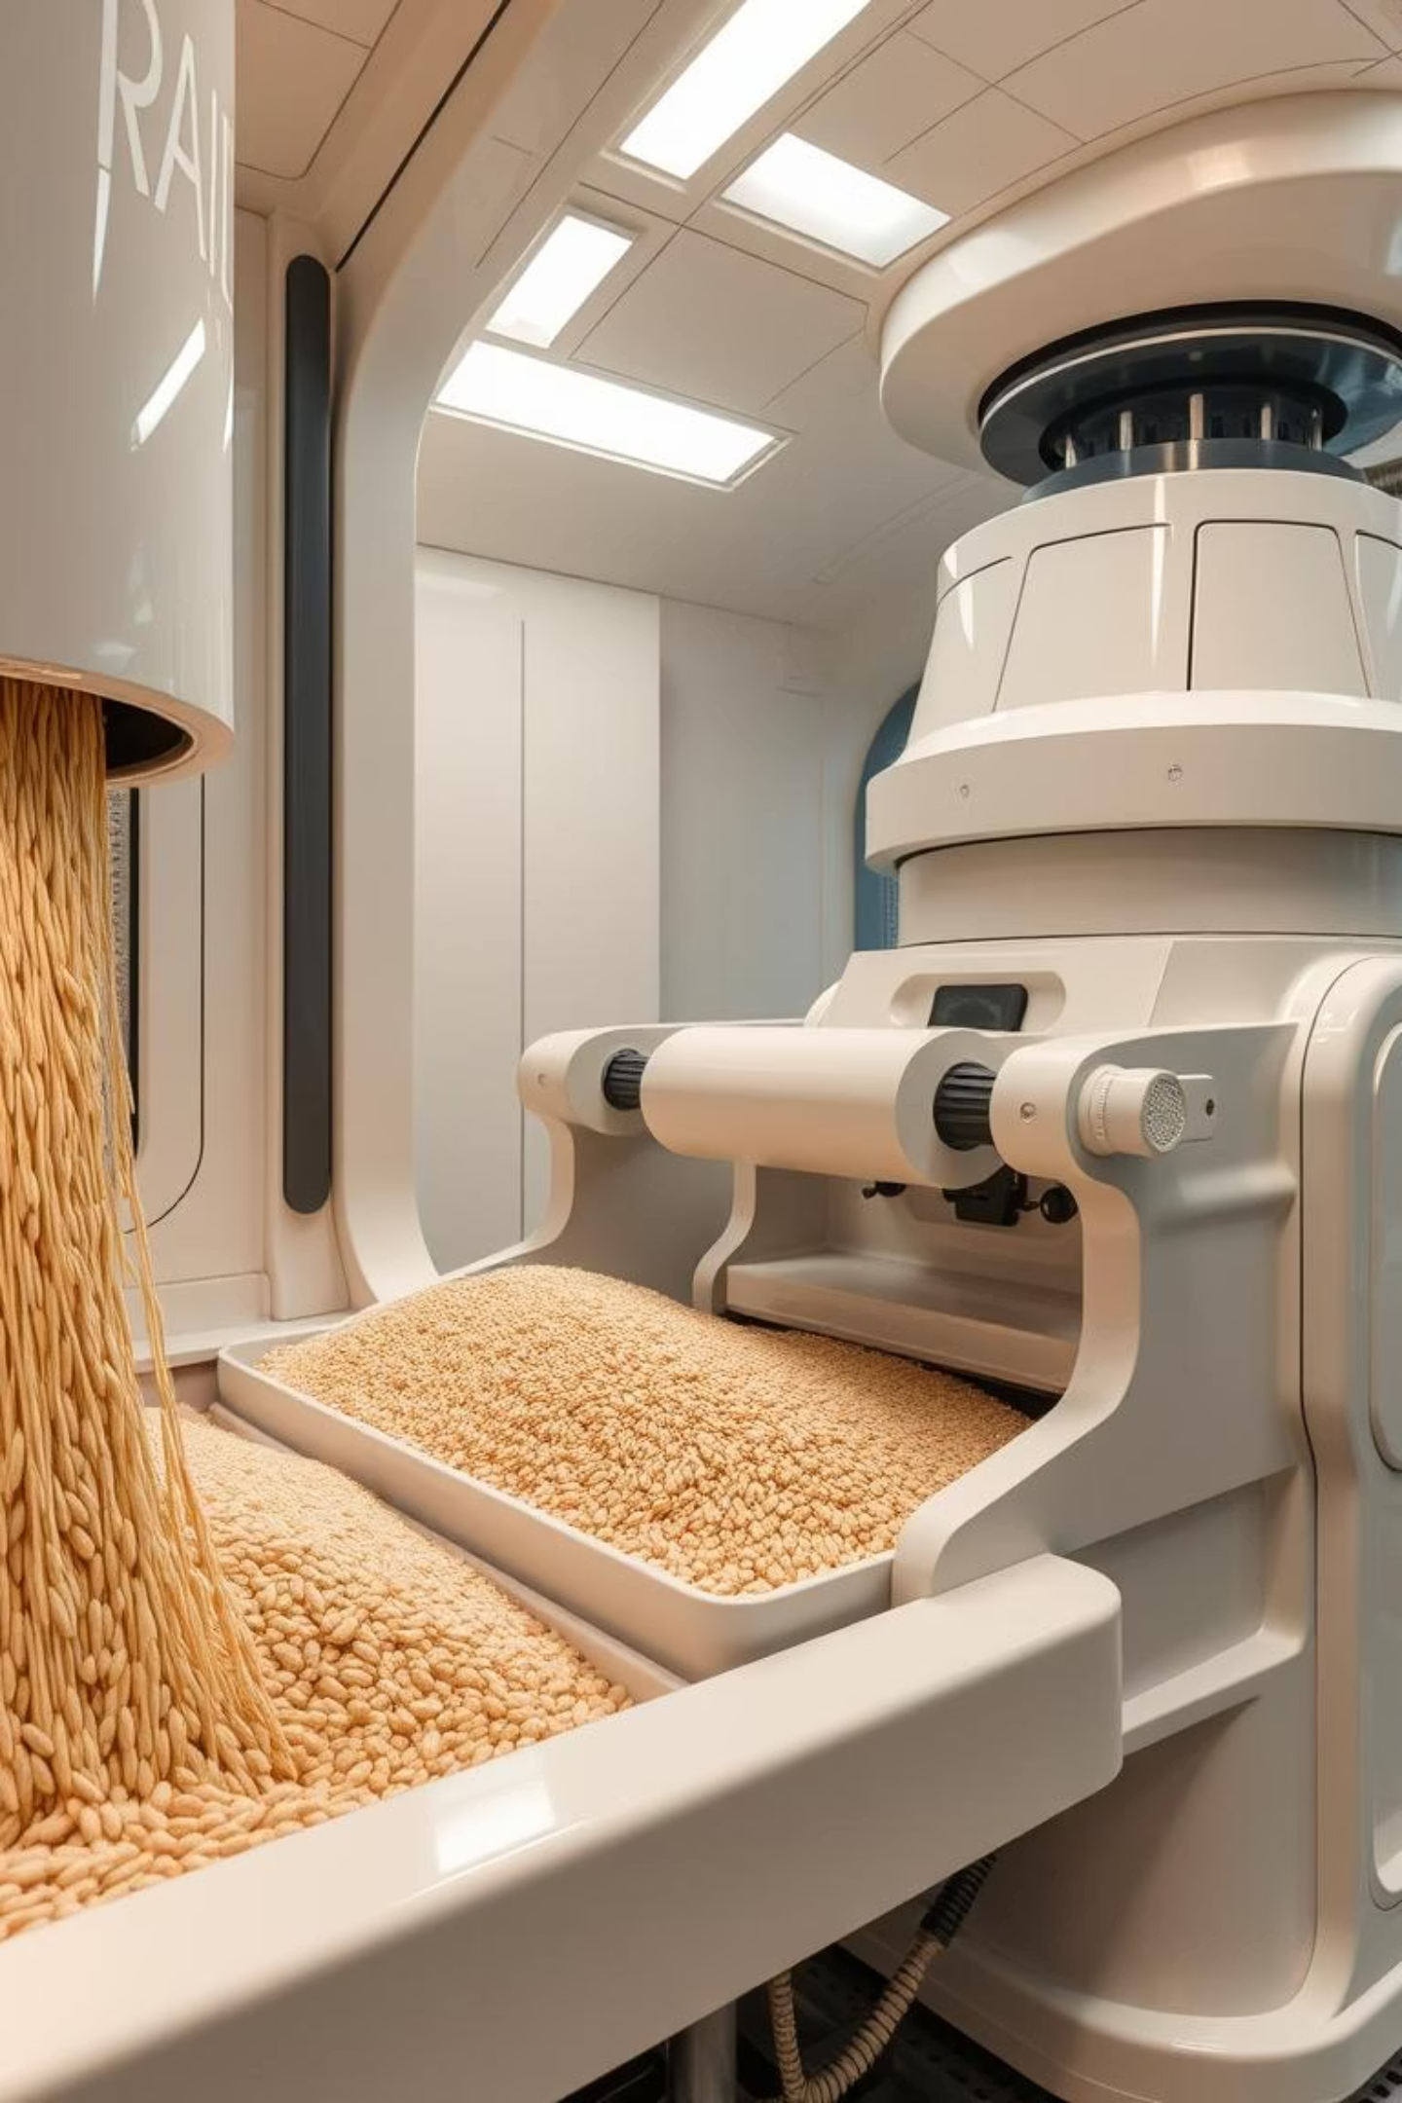
Beyond the Silo: Real-world Applications and Future Enhancements for GrainPalette
Applications
Automated sorting in mills.
Quality control at procurement centres.
Supply chain transparency.
Future Enhancements
Expand to more grain types.
Develop mobile application for field use.
Integrate with IoT devices for real-time monitoring.

Slide 12

Key Takeaways and Your Queries: Navigating the Future of Grain Classification
Precision Matters: Deep learning redefines rice classification.
Transfer Learning Power: Efficient and accurate model development.
Real-world Impact: Revolutionising agriculture for Bharat.
Team Members
Gorla Venkatesh (Team Leader)
Pamujula Tejesh
N Uday Kiran
Aripalli Varsha
Thank you! We welcome your questions and ideas for GrainPalette's next harvest.

